Slide 1
STM32 – IR communication
Dr. Federica Villa

Slide 2
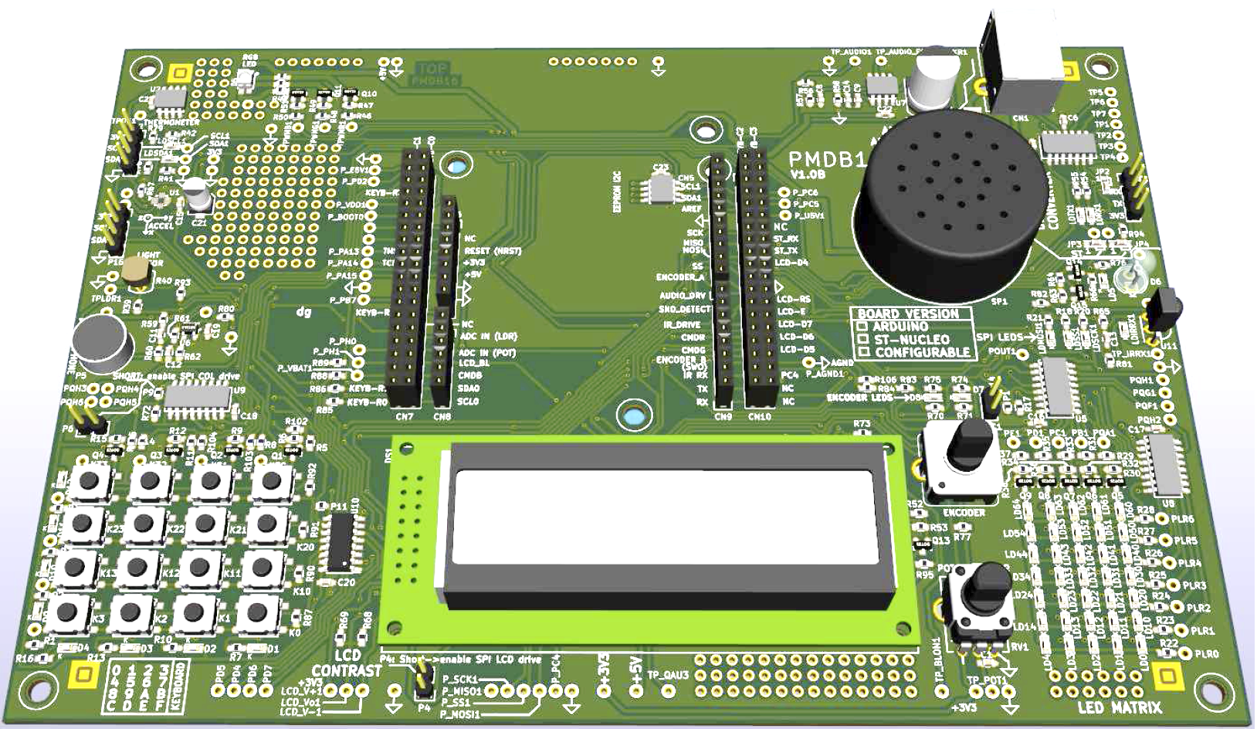
IR TX / RX – Evaluation Board Components Overview
IR LED
IR RECEIVER

Slide 3
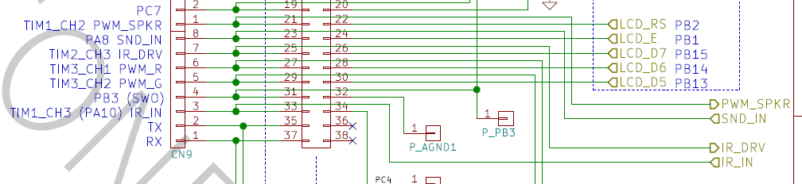
IR TX / RX – PMDB16 details
In our PMDB16 board:
IR LED (IR_DRV) is connected to PB10 (TIM2_CH3)
IR receiver (IR_IN) is connected to PA10 (TIM1_CH3 / USART1_RX)
Notes:
IN QUESTA PRIMA SEZIONE CI CONCENTRAREMO SULLA MATRICE DI LED, IN PARTICOLARE SU ALCUNI ASPETTI TECNICI E SU DEGLI ESEMPI PRATICI

Slide 4
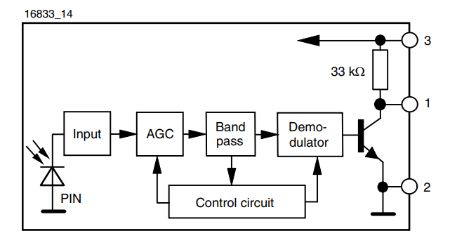
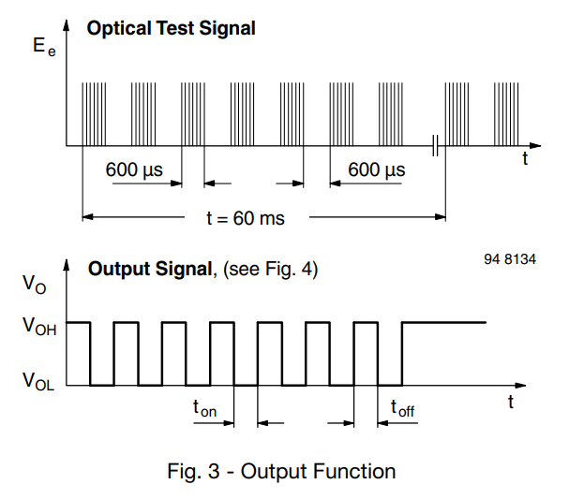
IR RX receiver – TSOP58238
Receiver consists of:
Photodiode
Amplifier with Automatic Gain Control (AGC)
Bandpass filter and demodulator (38 kHz)
Open-drain output with internal pull-up
Modulation allows to reject background light
Output goes LOW only when MODULATED light is detected
Notes:
IN QUESTA PRIMA SEZIONE CI CONCENTRAREMO SULLA MATRICE DI LED, IN PARTICOLARE SU ALCUNI ASPETTI TECNICI E SU DEGLI ESEMPI PRATICI

Slide 5
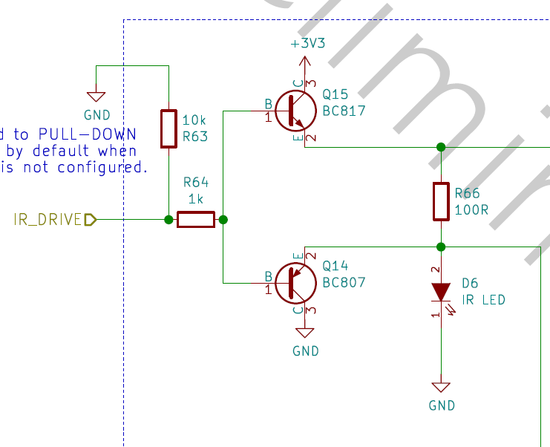
IR TX LED
Transmitter:
just a simple LED
«Class B» amplifier to drive more current (~ 20 mA) than what the microcontroller pins allow (typ. 8 mA)
We can use PWM to drive the LED at 50% duty cycle, 38 kHz, to stimulate the receiver
Notes:
IN QUESTA PRIMA SEZIONE CI CONCENTRAREMO SULLA MATRICE DI LED, IN PARTICOLARE SU ALCUNI ASPETTI TECNICI E SU DEGLI ESEMPI PRATICI

Slide 6
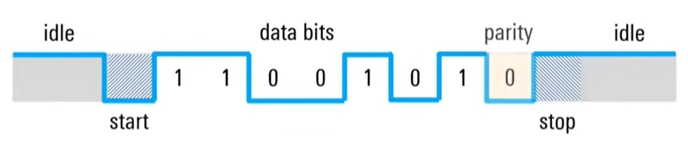
UART protocol
LSB MSB
BUS IDLE -> ‘1’
PAYLOAD
STOP BIT -> ‘1’
START BIT -> ‘0’
PARITY (optional)
This diagram is what we want to get at the receiver side:
To transmit (receive) a ‘1’ → LED stays OFF
To transmit (receive) a ‘0’ → LED pulses at 38 kHz
Bit time = 1/(Baud rate) Suggested baud rate ≤ 2400 bps
Notes:
IN QUESTA PRIMA SEZIONE CI CONCENTRAREMO SULLA MATRICE DI LED, IN PARTICOLARE SU ALCUNI ASPETTI TECNICI E SU DEGLI ESEMPI PRATICI

Slide 7
IR - Project 1 - Preliminary
The group should split into 2 sub-groups:
Transmit and Receive
Objective of this project is to prepare the two boards to allow wireless communication between them

Slide 8
Transmit board – project 1
Step 1:
Create a function that sends a byte via «Infrared UART» at 2400 bps baud rate:
Set up a timer (TIMx) to provide an interrupt every 1/2400 s
When the function gets called, enable TIMx in interrupt mode
Send the start bit by enabling TIM2_CH3 PWM at 38 kHz, until the TIMx interrupt
Send the 8 bits, one at a time, enabling / disabling the PWM according to the bit to send
Send the stop bit by disabling PWM
Step 2:
Create a function to send strings exploiting what made in step 1.
Notes:
IN QUESTA PRIMA SEZIONE CI CONCENTRAREMO SULLA MATRICE DI LED, IN PARTICOLARE SU ALCUNI ASPETTI TECNICI E SU DEGLI ESEMPI PRATICI

Slide 9
Receive board – project 1
Step 1:
Receive data via UART, using USART2 in interrupt mode.
Suggestion: receive 1 byte in interrupt mode. When byte is received, immediately restart receive mode, and store previously received byte.
React to received byte:
Turn on green LED if you receive a ‘1’
Turn off if you receive a ‘0’
You can debug by sending data via putty (just type in the window to send data).
Step 2:
Switch to receiving from the IR USART1, at 2400 bps baud rate.
Send the byte received with USART1 to the PC via USART2, using both in interrupt mode. Help the other half group debug their sending code.
Notes:
IN QUESTA PRIMA SEZIONE CI CONCENTRAREMO SULLA MATRICE DI LED, IN PARTICOLARE SU ALCUNI ASPETTI TECNICI E SU DEGLI ESEMPI PRATICI

Slide 10
Transmit - Project 2 - Objective
Objective
Communicate between boards

Slide 11
Project objective
Objective of the project for the Transmit board is:
Scan the pushbutton matrix (as in M13 project 1b) and send the data corresponding to the pressed button via IR UART
Objective of the project for the Receive board is:
Receive the IR UART data and display the corresponding character on the LED matrix (as in M11 project 1b)
OR
Just play around and make the boards do whatever you like, as long as wireless communication via IR is involved

